Slide 1

IPL DATA ANNALYSIS
PROJECT PARTNER :
Mohit Samal(1801104139)
Abinash Jena (1921104019)
Ashutosh Malla (1921104021)
Soubhagya Ranjan Pradhan(1801104238)
Guided By :
Mr Amiya Bhusan Bagjdav

Slide 2

Contents :
Abstract of project
Introduction
Motivation
Objectives of the IPL Data Analysis
Propose system
Feasibility study of IPL data Analysis
Requirement analysis
Road map to complete the Project
Diagram
Partial Implementation
Conclusion
Reference

Slide 3
Abstract
Cricket is one of the popular game in India. After the Start of IPL, Indian cricket standards reached an ultimate level and many talented players got a chance to prove themselves in a platform like IPL where many international cricketers play together. IPL is one of the leading cricket tournament in the world. So, I am here to describe the IPL analysis using Python.

Slide 4
Introduction
Data science is the study of data to extract knowledge and insights from the data and apply knowledge and actionable insights. We will work on IPL Data Analysis and Visualization Project using Python where we will explore interesting insights from the data of IPL matches like most run by a player, most wicket taken by a player, and much more from IPL season 2008-2020.

Slide 5
Motivation
Indian Premier League is a famous cricket league played in India every year during the period between March and May. It is played in a professional T20 format of the game. This league is played by 8 teams representing 8 different cities across India. This league started in 2008 and it has been a big hit and it is the most attended league in the World. Each team with their profit buys best players from across the World. It is also one of the big reason behind Indian team's success as the league brings out the best talent from a billion population in India.

Slide 6

OBJECTIVES :
The process of data analysis uses analytical and logical reasoning to gain information from the data.
The main purpose of IPL data analysis is to find meaning in data so that the derived knowledge can be used to make informed decisions
To find the team that won the most number of matches in a season.
To find the team that lost the most number of matches in a season.
Does winning toss increases the chances of victory.
To find the player with the most player of the match awards.
To find the city that hosted the maximum number of IPL matches.
To find the most winning team for each season.
To find the on-field umpire with the maximum number of IPL matches.
To find the biggest victories in IPL while defending a total and while chasing a total.

Slide 7
What is IPL Data Analysis :
In IPL data annalysis we take the previous data set and visualise,annalyse it to get some information for taking decision
Why Data is Important For IPL ?
So much money is being spent in IPL. Data Collection and Data Analysis in IPL has breached the next level, because as IPL spending lot of money on players, it has become necessary for IPL teams to find out that, “Should they spend on a particular player or not?” or “How valuable is the player going to be for the team?”

Slide 8
Existing System
In the existing system there is a formula to calculate the projected score and a win predictor based on the win percentage of a team and polls.
These techniques won’t give accurate results because they are based on perceptions and predictions based on a particular instant
Consider calculating projected score, the formula.
Projected score = current run rate * overs in an innings.
The average accuracy obtained by following the above technique is very less.
Proposed System
Use algorithm to predict the winning percentage
The system scrapes data of all IPL matches from 2008 to 2020 from kaggle.com.
And then we perform Data Cleaning followed by Data Preprocessing. Data Analysis and Visualization is done to make better understanding of the results and exploring various valuable insights.

Slide 9
Market Feasibility
Feasibility study
Of
IPL Data Analysis
Technical Feasibility
Financial
Feasibility

Slide 10
Market Feasibility :
IPL teams have started hiring proper companies who are experts in such Data Analysis. Performance Analytics Companies that analyze how good players are, and develop strategies for that players. These Data Analysis companies analyze data about players in detail to understand who is good at what aspect. In IPL a metric that they use, is MVPI or The Most Valuable Player Index, which is a weighted composite score of the different attributes of a player.
From these it is clear that the project is Market Feasible

Slide 11
Technical Feasibility :
The Project IPL Data Analysis is complete Data Analysis Project.
The main technologies that are associated with IPL data Analysis are
Power Bi for dash-board design
Python Machine Learning Scripting Language
Numpy
Pandas
Matplotlib
Seaborn
Each of the technologies are freely available and the technical skills are manageable
From these it is clear that the project is Technically Feasible

Slide 12
Requirement Analysis :
Hardware
• Core I3 processor or higher
• 256 MB RAM or more
• 700 MB HDD or more
Software
Any Operating System
Windows 10 or more
Jupyter Notebook
VS code
Power BI

Slide 13
Technologies :
Document And Presentation Tools :
Microsoft word 2007
Microsoft Power Point
Numpy
Pandas
Matplotlib
Google Colab
Power BI
IPL DATA SET

Slide 14
Financial feasibility :
Being a Data analysis project it will not have associated with any types of cost
The system will follows the freeware software standards. No cost will be charge from the potential customer.
And there is no maintenance cost also.
From these it is clear that the project is Financial Feasible

Slide 15


Roadmap
Starting of technical work
Create documenation
Week-1
Week-3-4
Week-2
Week-5
Collect data set
Still doing the code part

Slide 16
START
DIAGRAM
DATA GATHERING
DATA UNDEDRSTANDING
DATA CLEANING
DATA PROCESSING

Slide 17
PARTIAL IMPLEMENTATION
Installation of virtual studio code was done
Installation of python was done
All the modules required for project were installed
Installation of jupyter notebook was done
Collection of IPL data of 2008 to 2020 was done

Slide 18
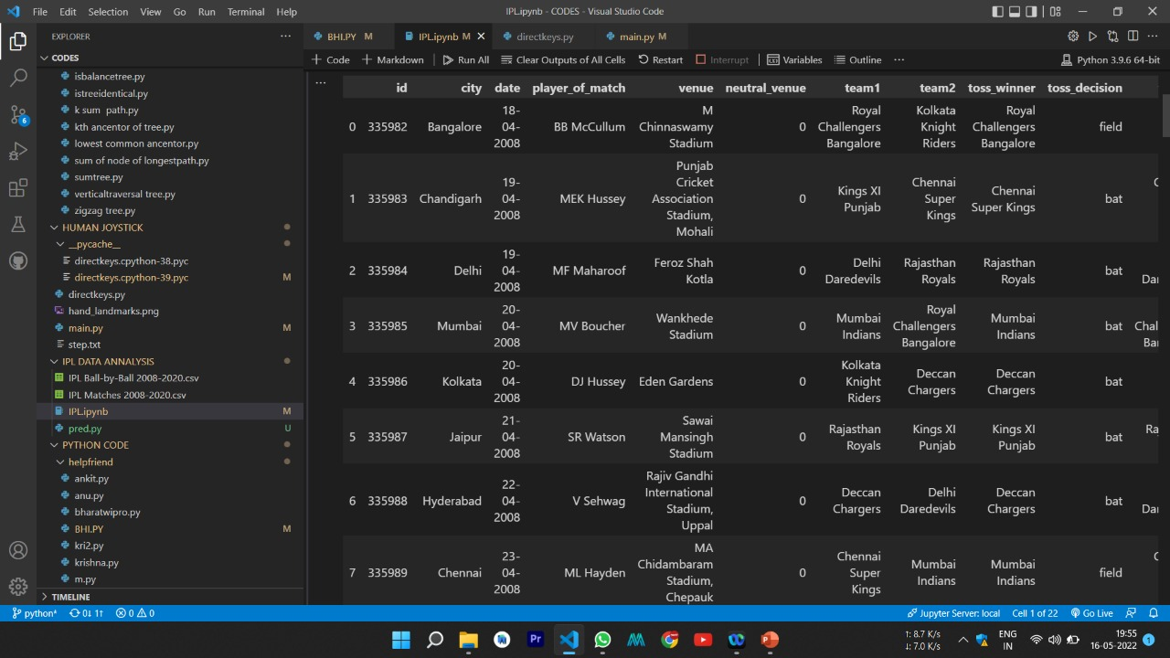
6.Data cleaning was done

Slide 19
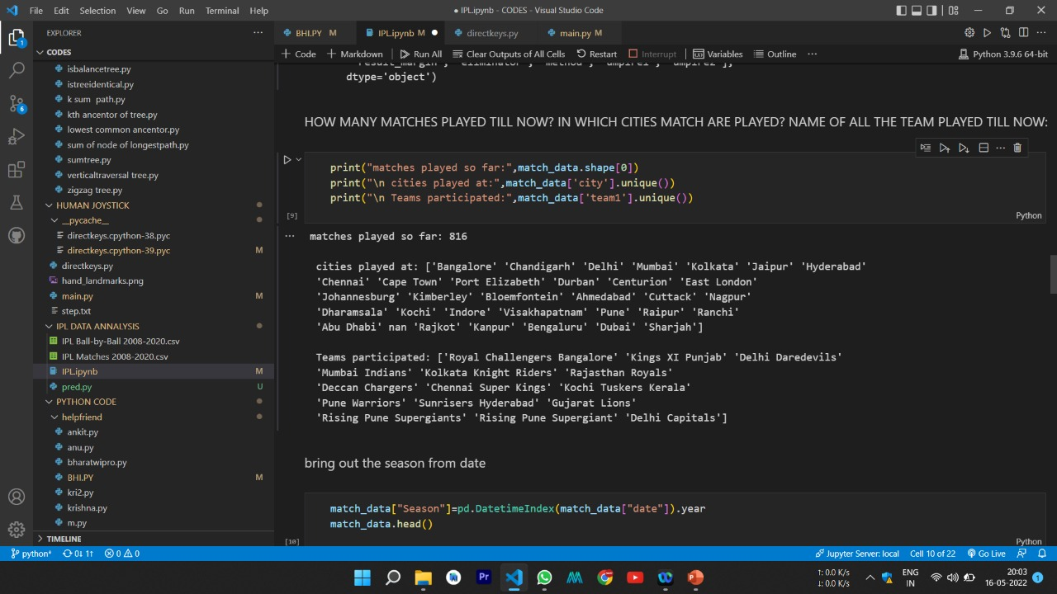
7.How many matches played till now,
In which cities matches are played
Name of all team played ipl till now

Slide 20
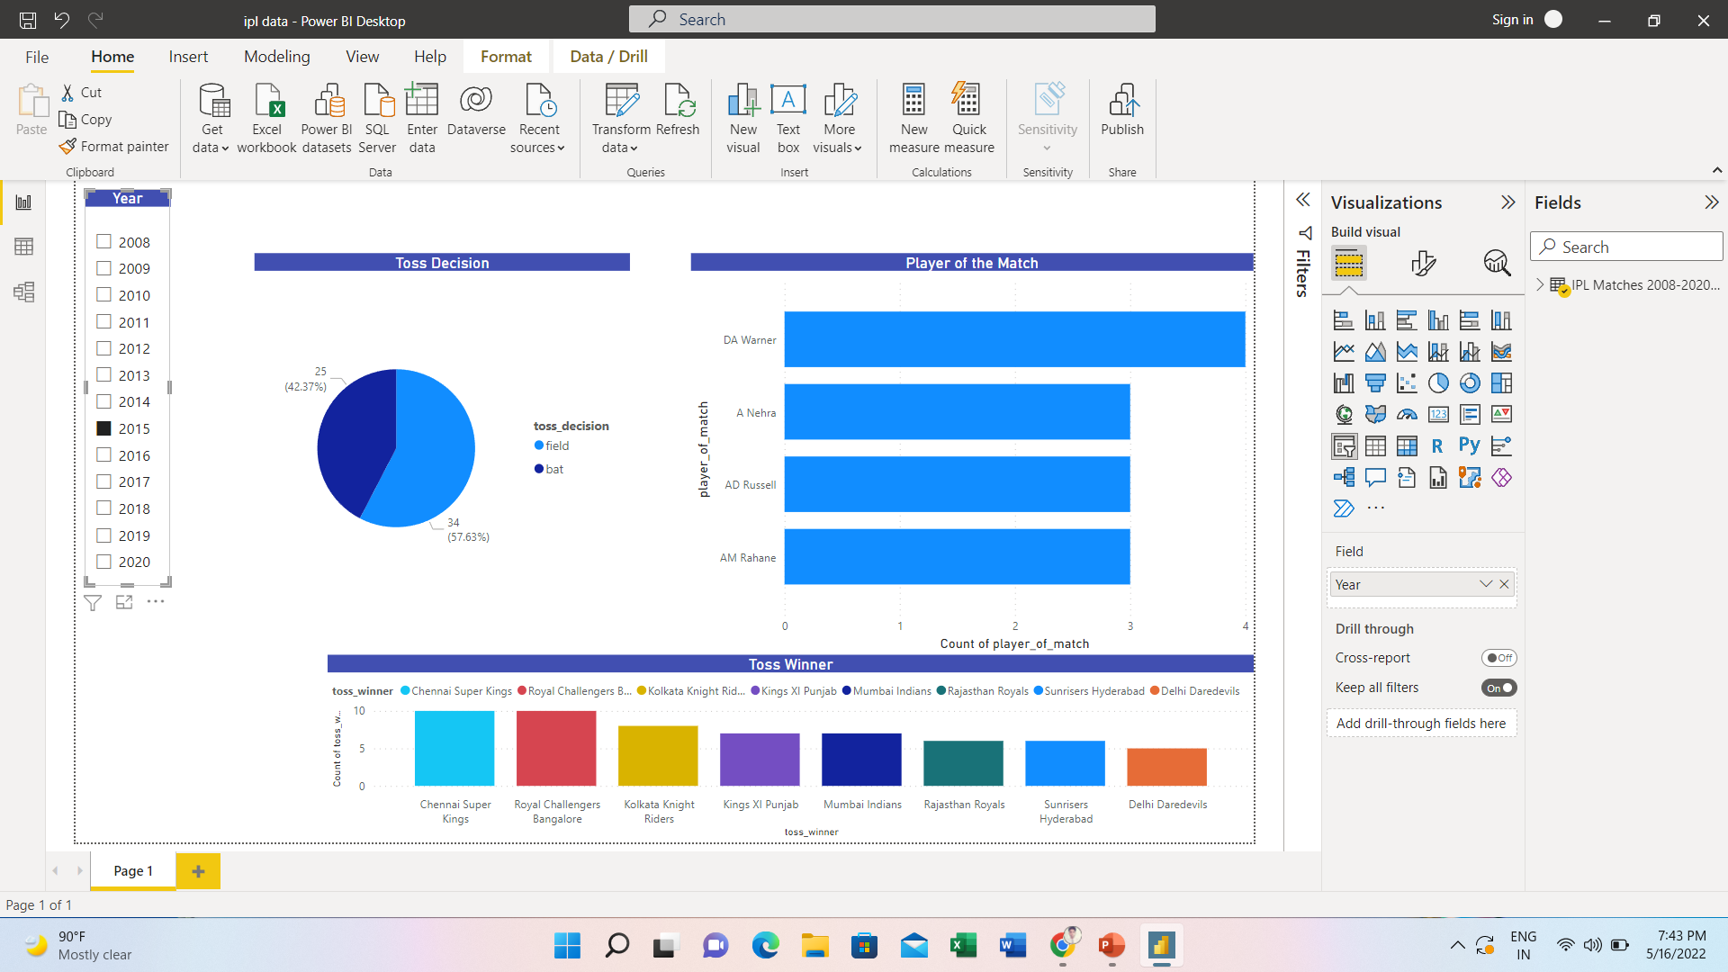
8.Implentation of dash board

Slide 21
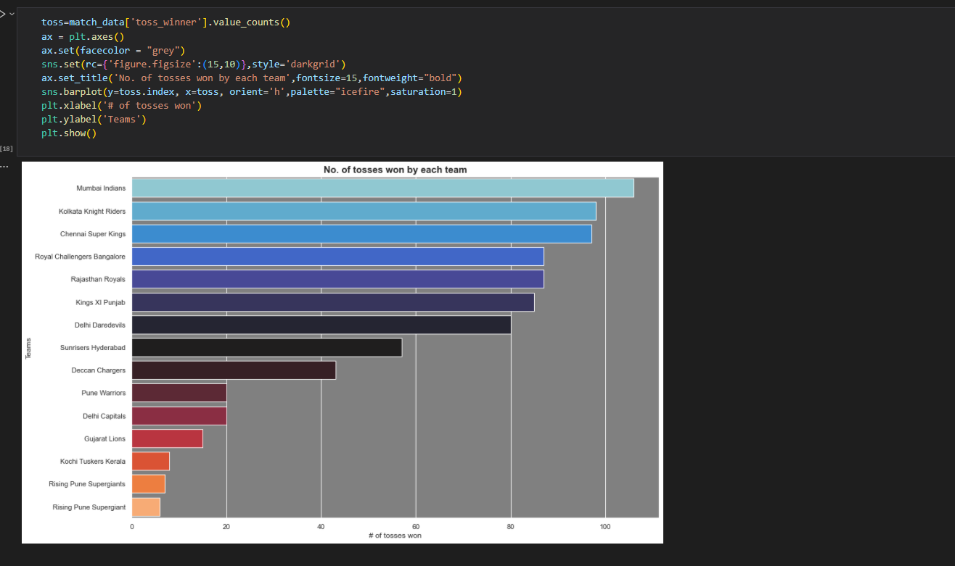
8.No of toss win by each team

Slide 22
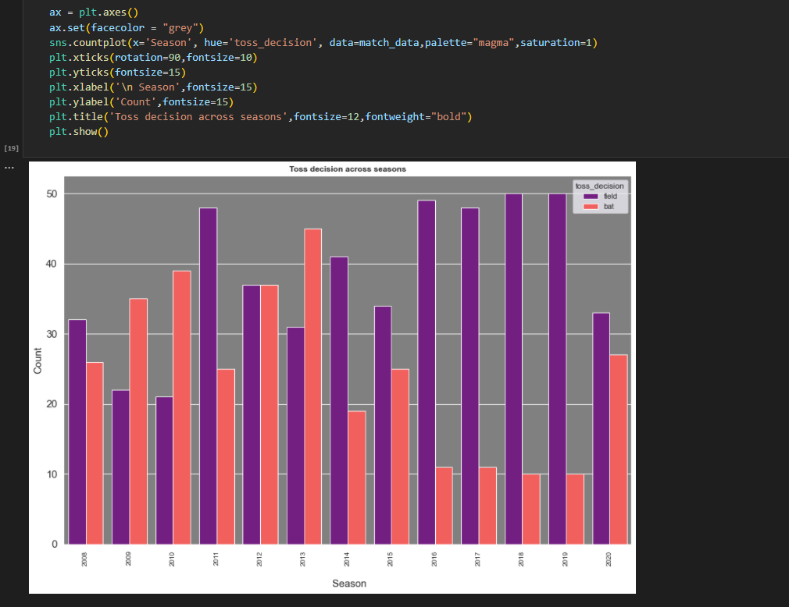
9. Toss decision across season

Slide 23
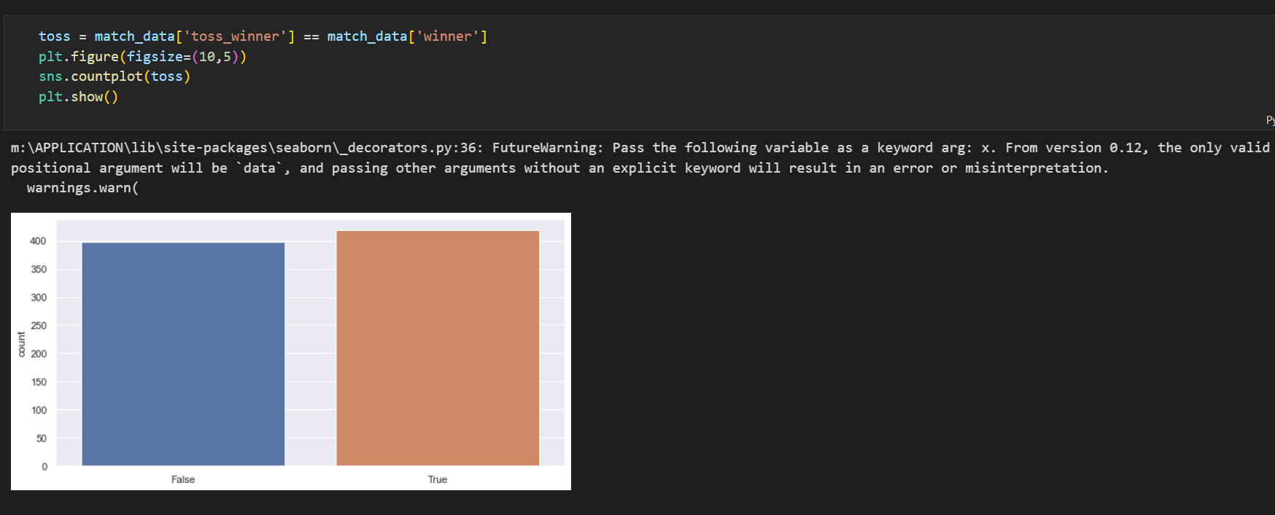
10.Does winning toss increase the chance of winning?

Slide 24
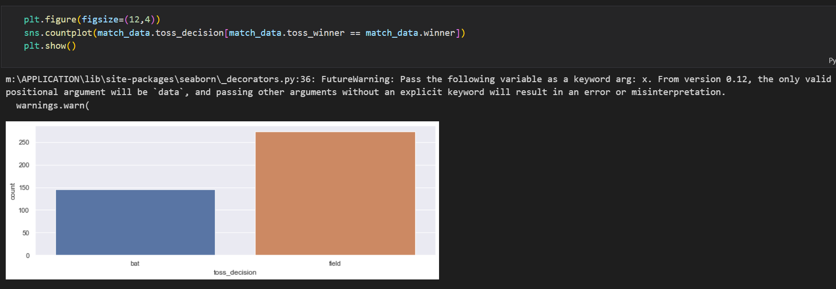
11.Decision taken after toss wining

Slide 25
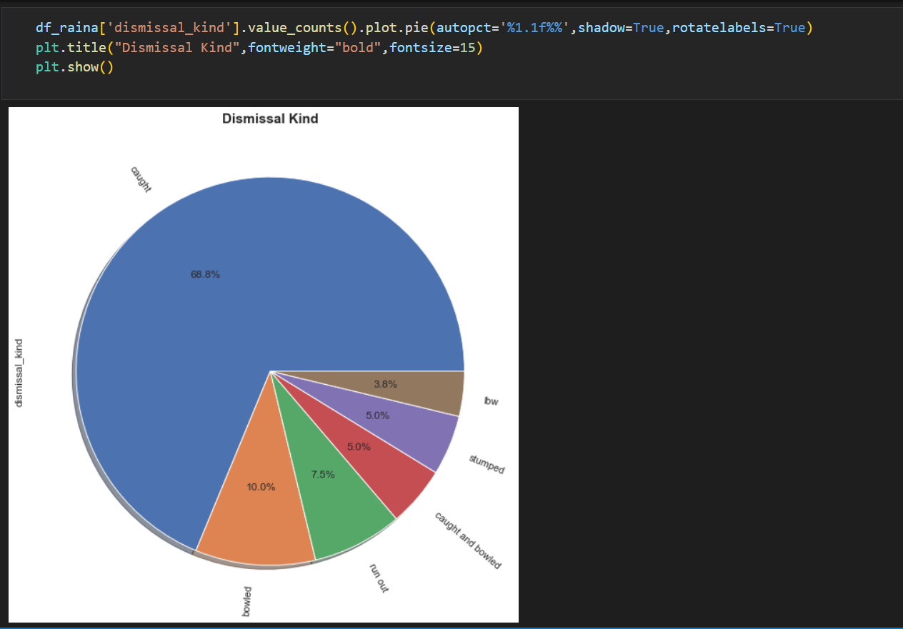
12.Out percentage in pie graph

Slide 26
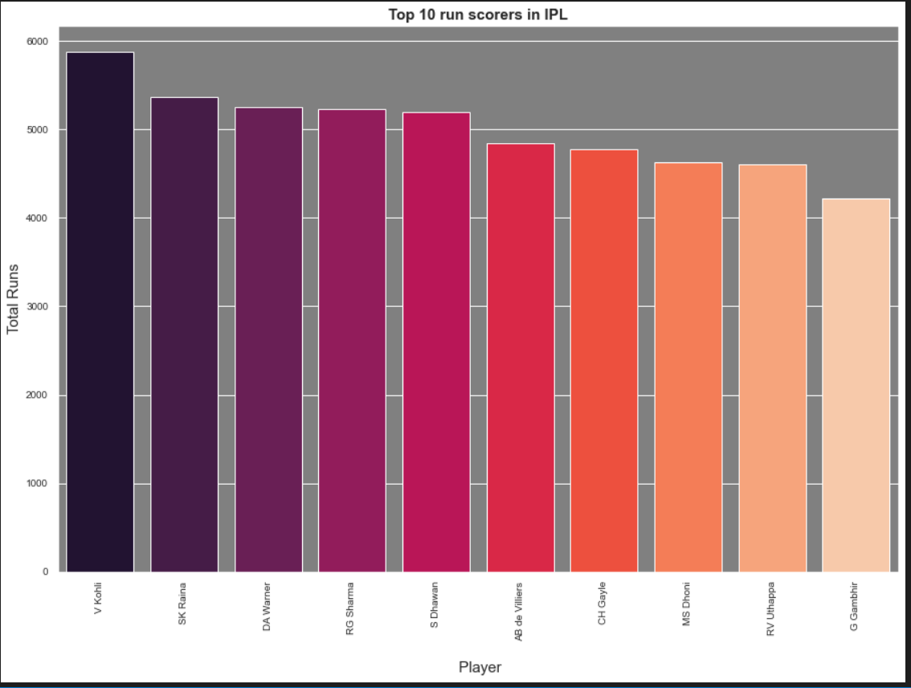
13.Top 10 run scorer in IPL

Slide 27
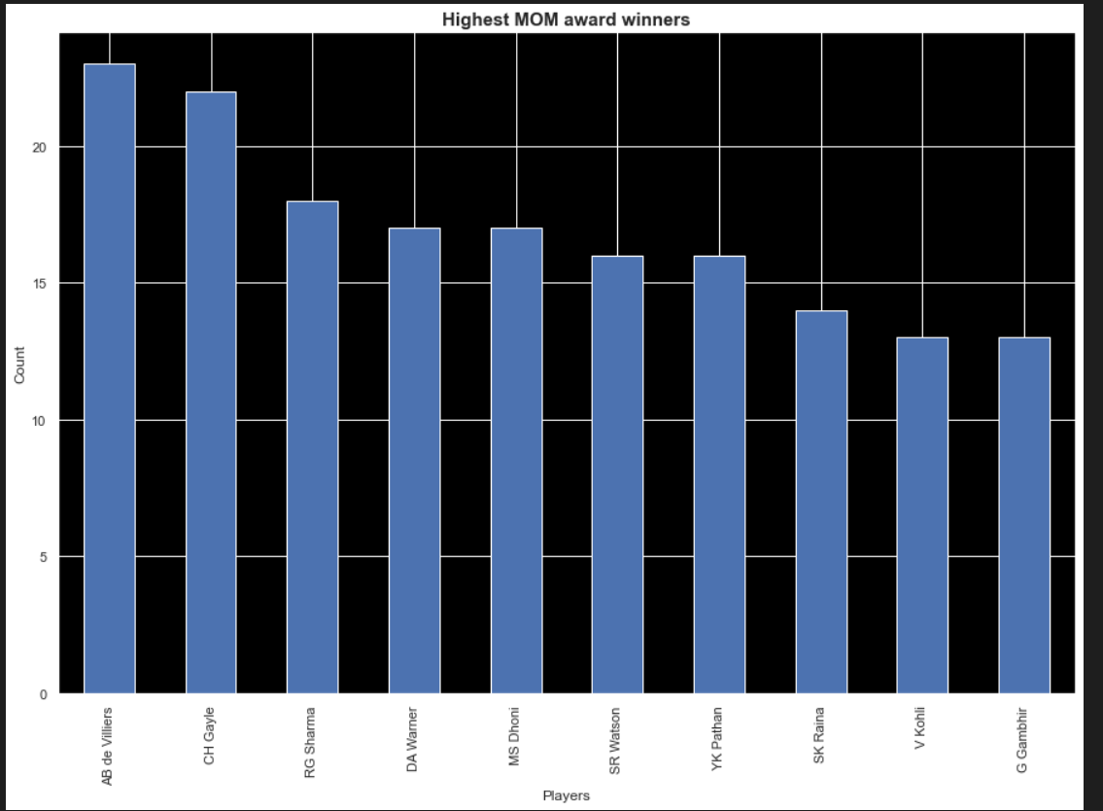
14.Highest Man of the match award

Slide 28
USER INTERFACE FOR OUR PREDICTION

Slide 29
Conclusion :
At the end of this IPL data analysis project. We will study how to create data visualization.
With this we will conclude observation on our objective

Slide 30
Reference:
Wes McKinney, “Python for data analysis 1st edition”,O’Relly Media ,pp.9-34,2012
Wes McKinney, "Python for data analysis 2nd edition" , O’Relly Media ,pp.67-83,2017
Mrunal Patill, Vidya Kumari, Adarsh Patil, Laxmikant Ahire and
Asst.Prof.Umakant Mandawkar "IPL DATA ANALYSIS USING GPLOT" ,Journal of Engineering Science by Dept. Of Computer Science and Engineering, Sandip University, Nashik, July 2012

Slide 31


